Slide 1
Linear Discriminant Analysis
Noble Xavier

Slide 2
LINEAR DESCRIMINANT ANALYSIS (LDA)

Slide 3
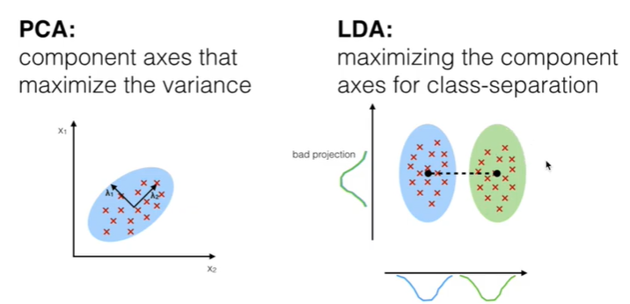
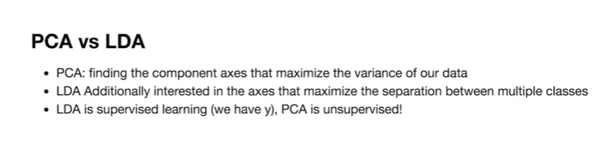

Slide 4


Slide 5
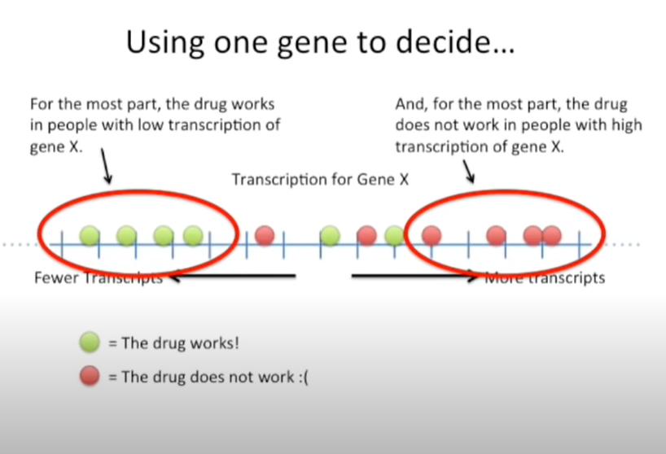

Slide 6
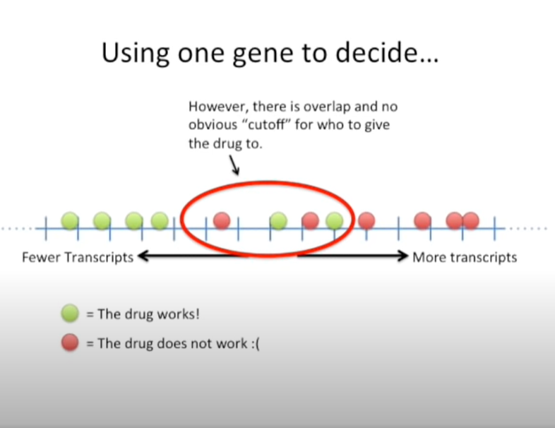

Slide 7
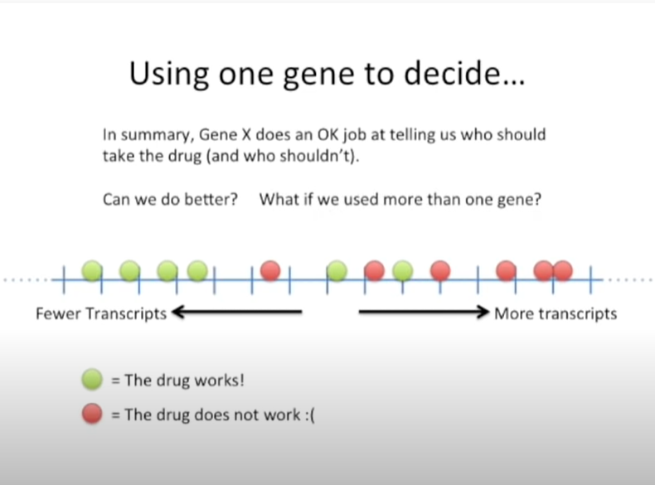

Slide 8
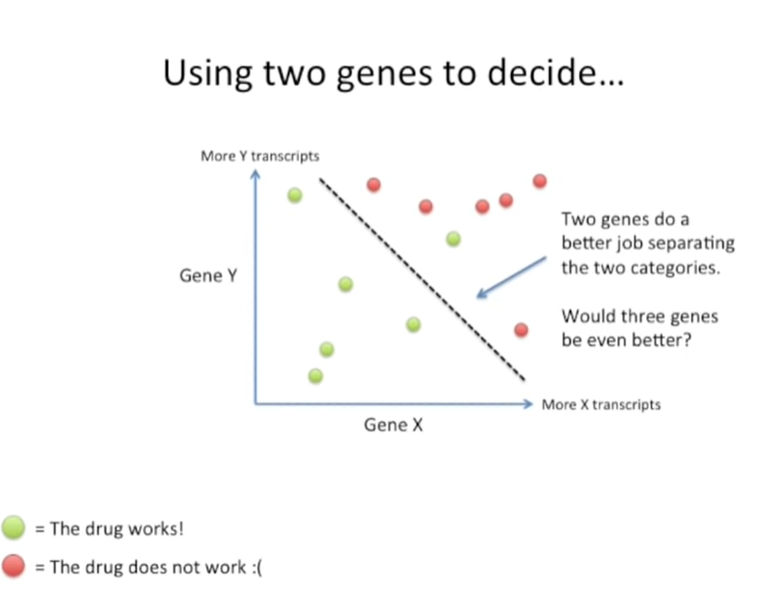

Slide 9
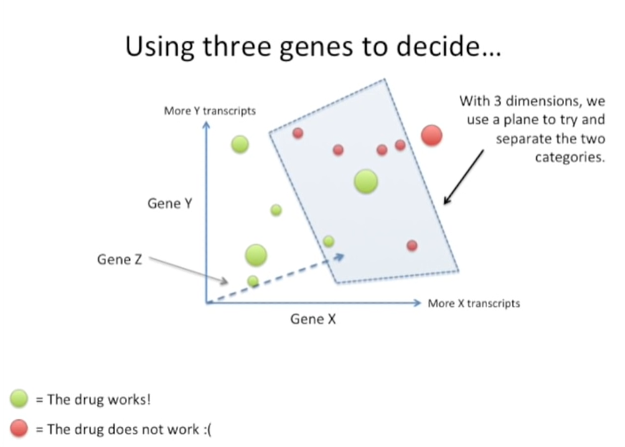

Slide 10
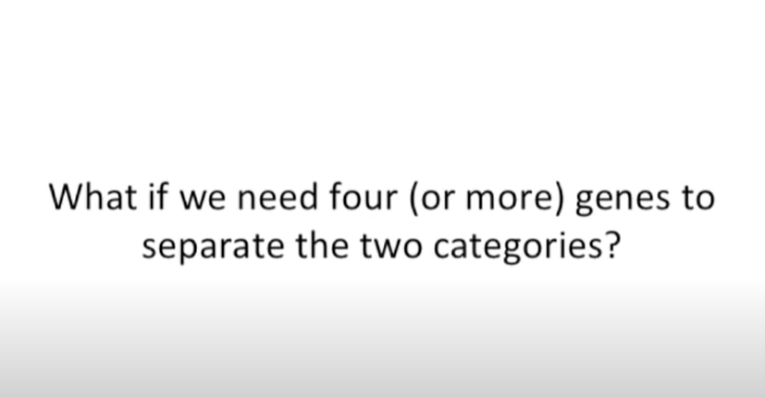

Slide 11
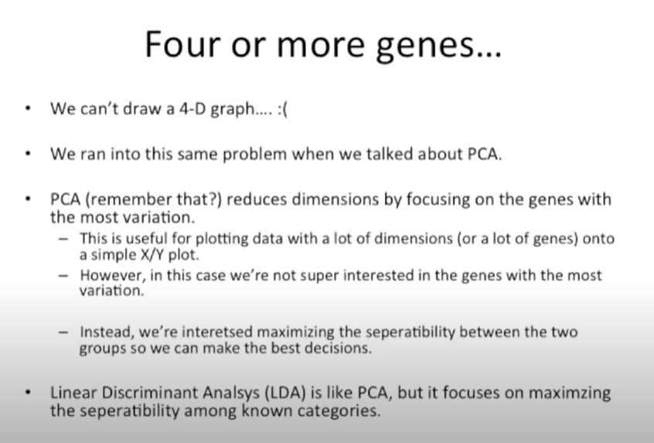

Slide 12
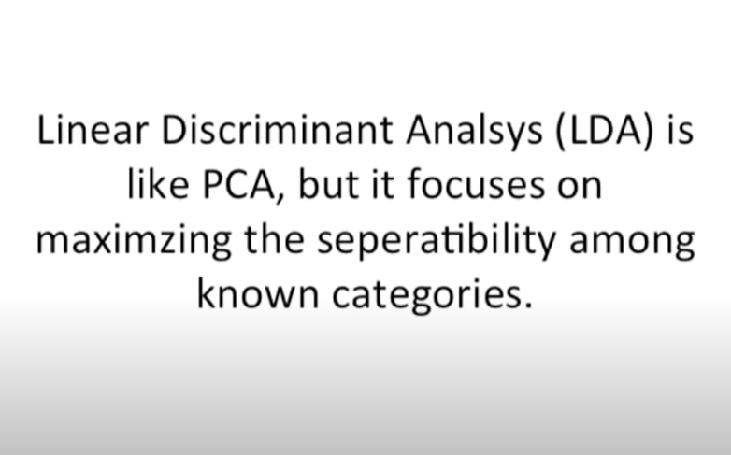

Slide 13
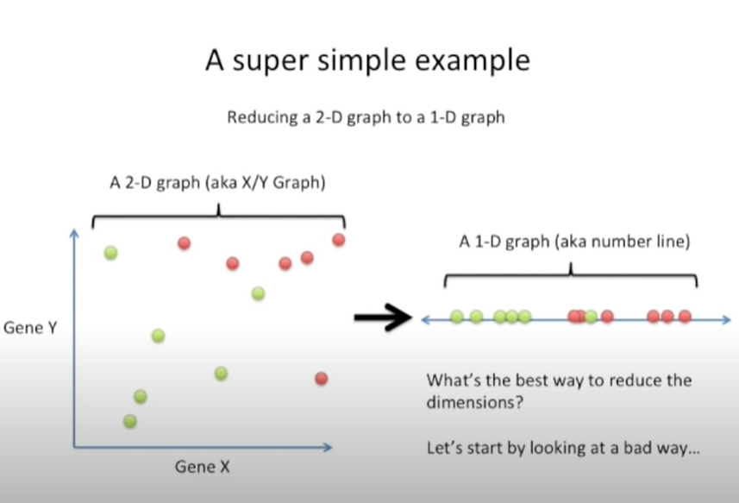

Slide 14
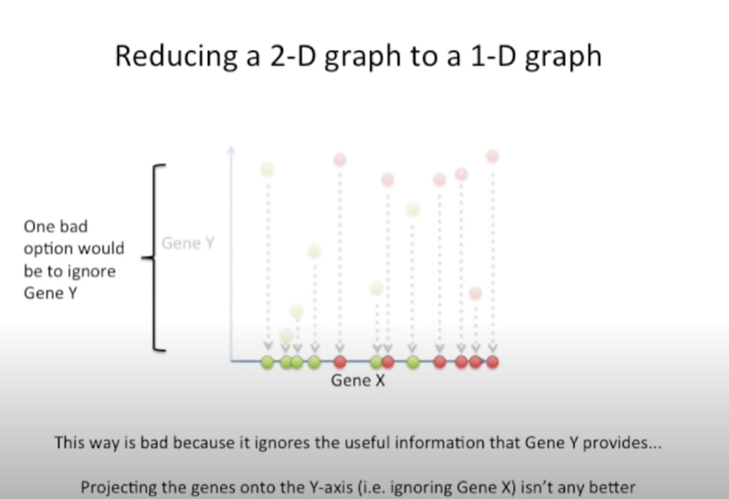

Slide 15
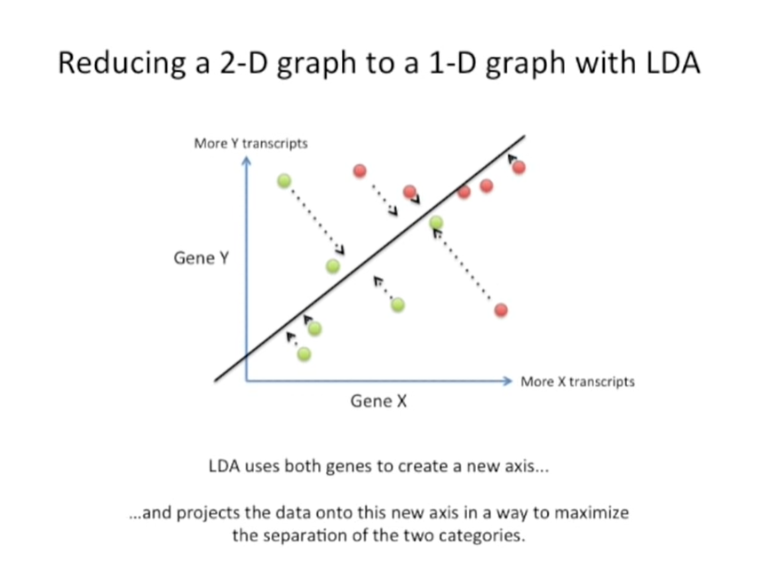

Slide 16
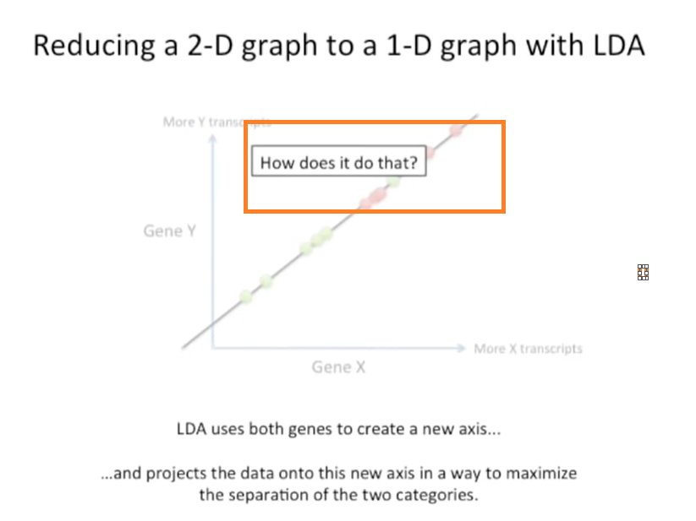

Slide 17
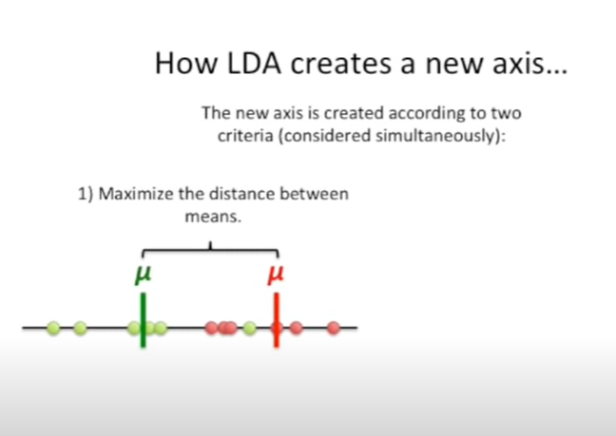

Slide 18
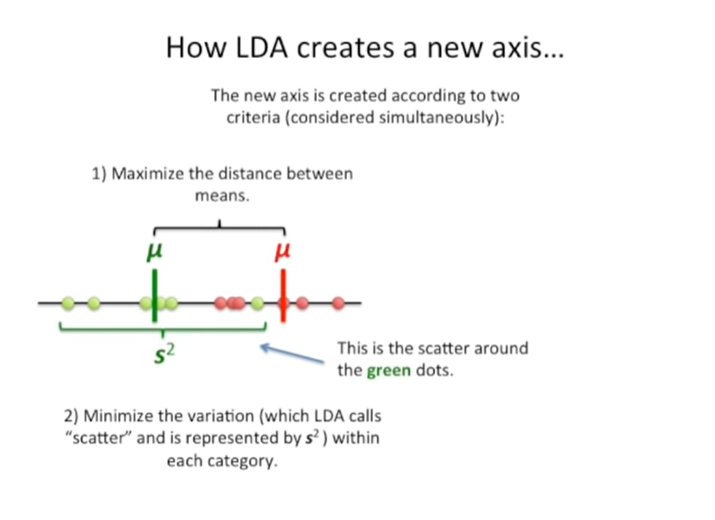

Slide 19
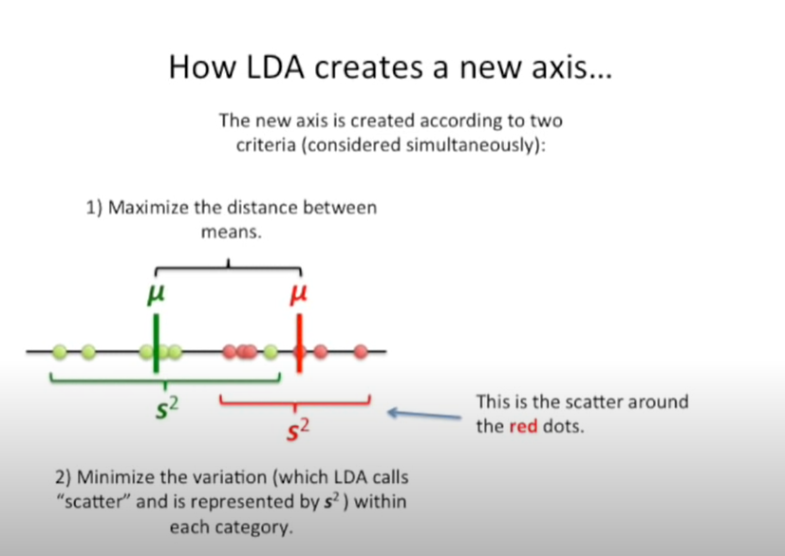

Slide 20
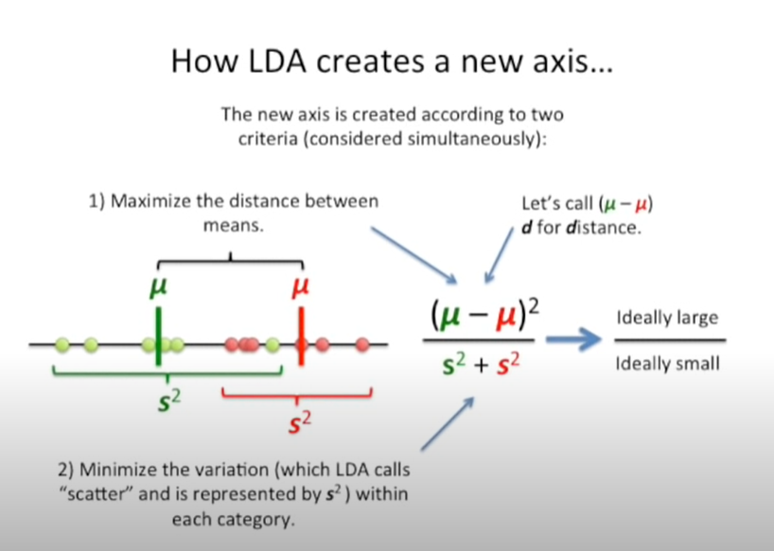

Slide 21
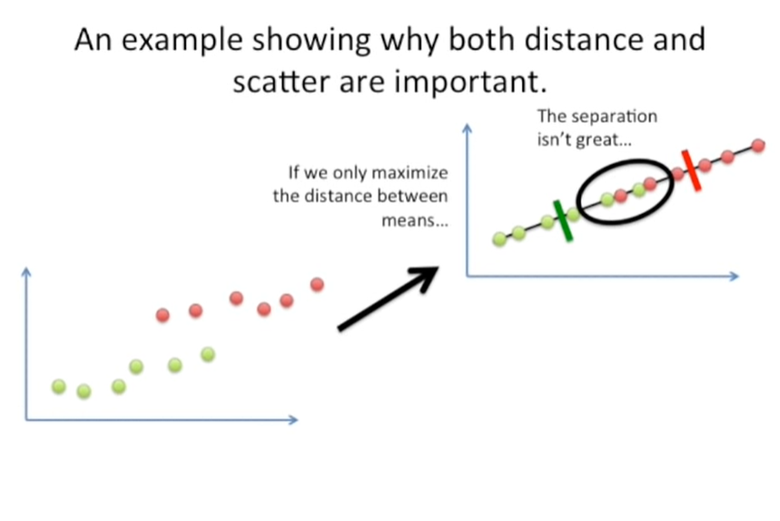

Slide 22
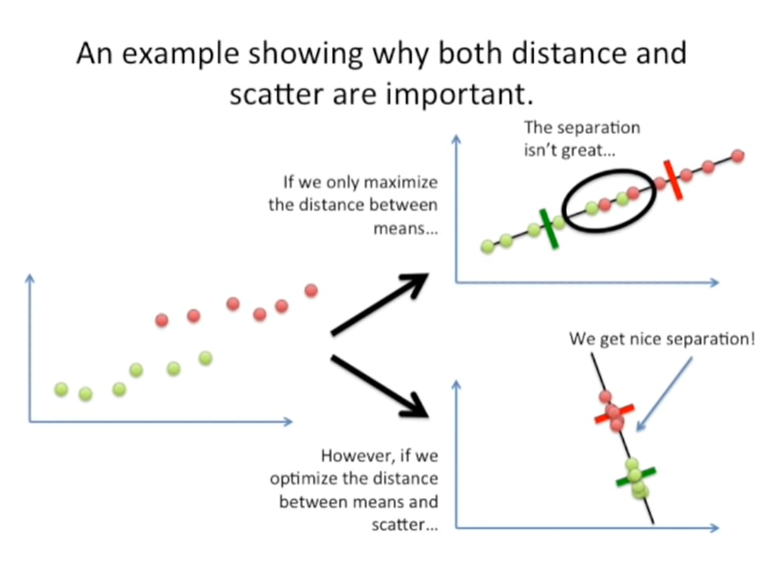

Slide 23
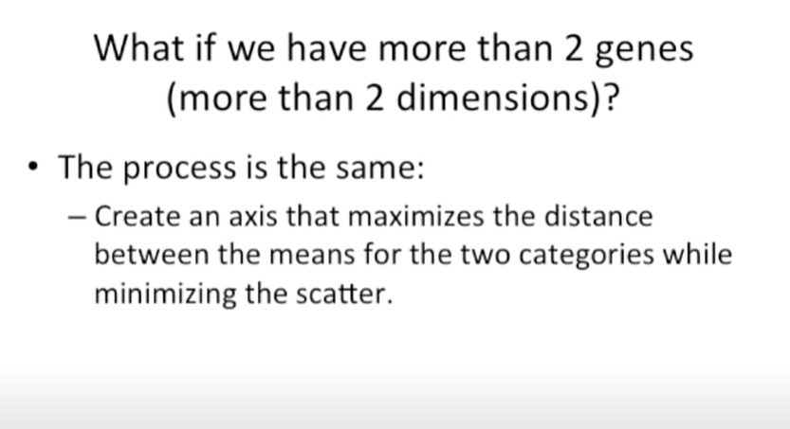

Slide 24
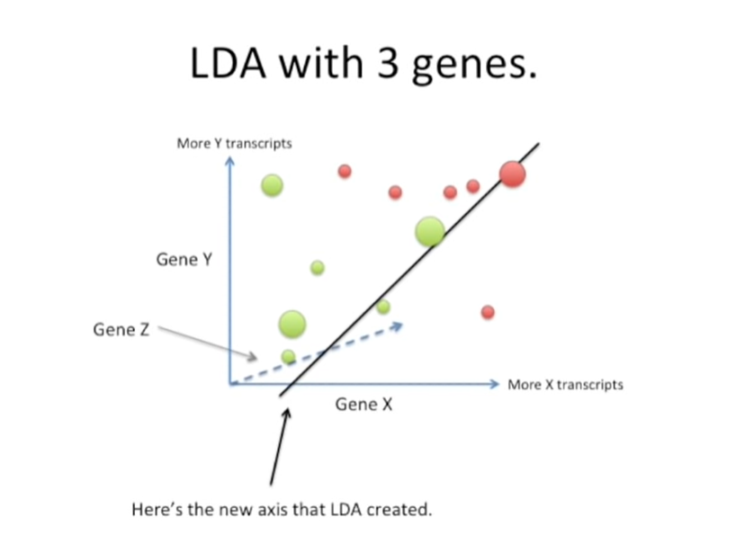

Slide 25
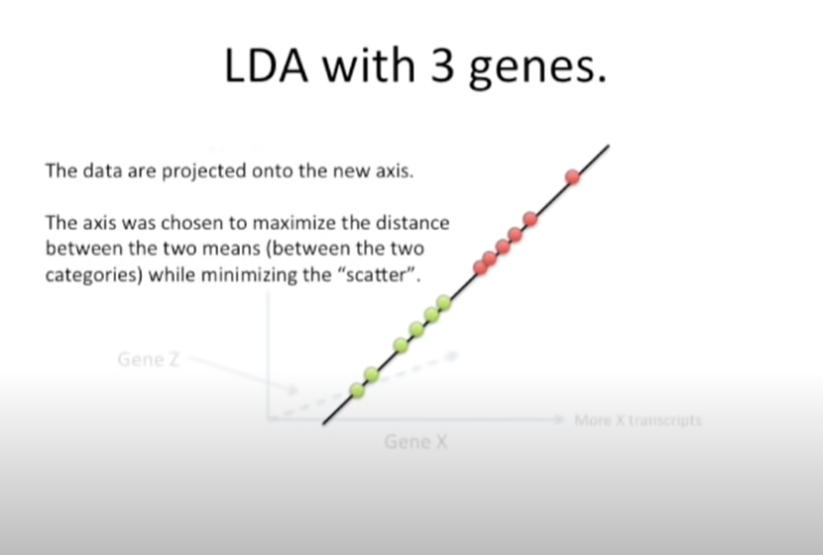

Slide 26


Slide 27
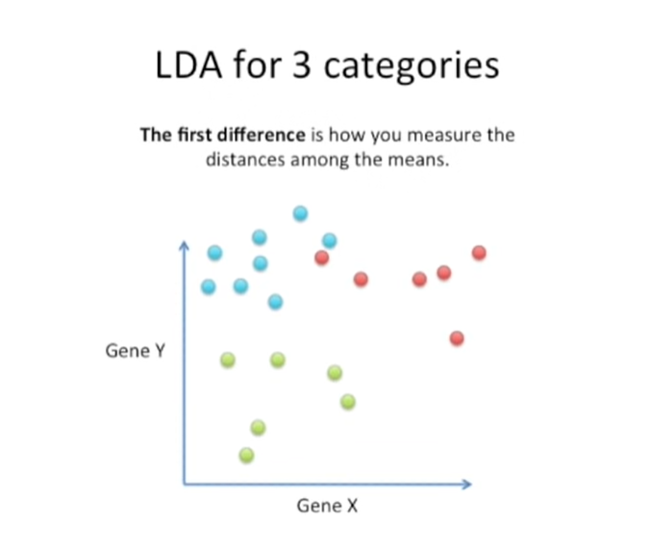

Slide 28
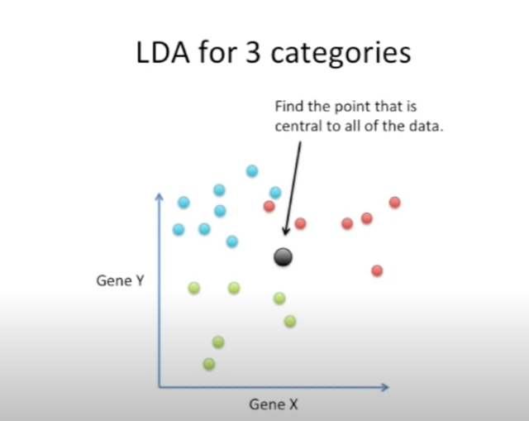

Slide 29
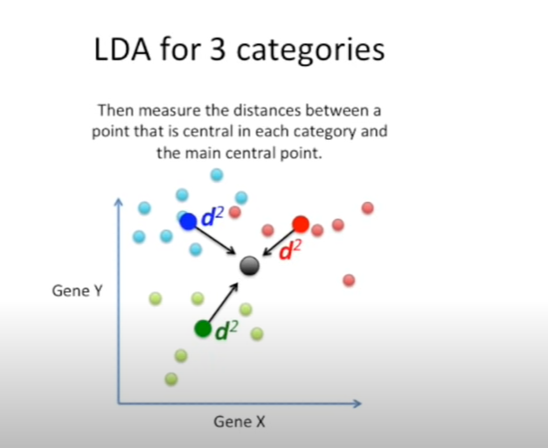

Slide 30
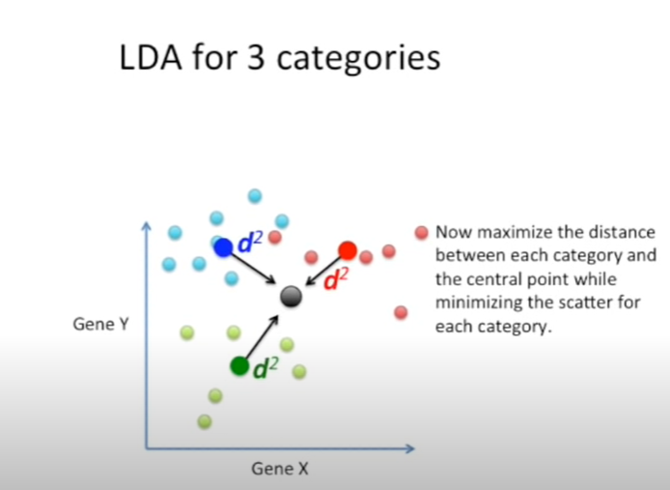

Slide 31
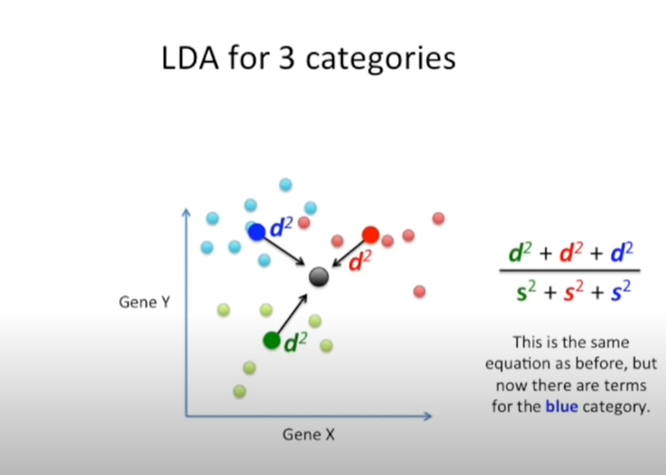

Slide 32
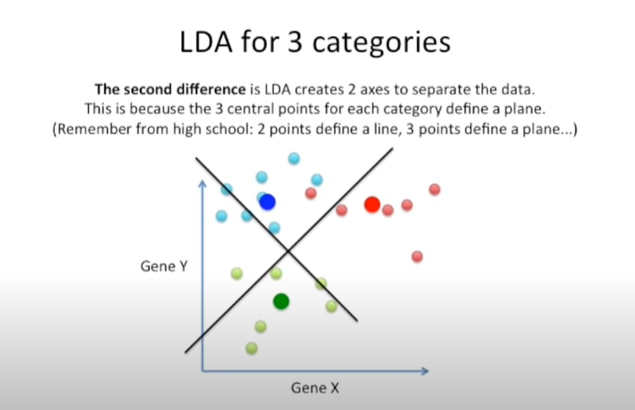

Slide 33
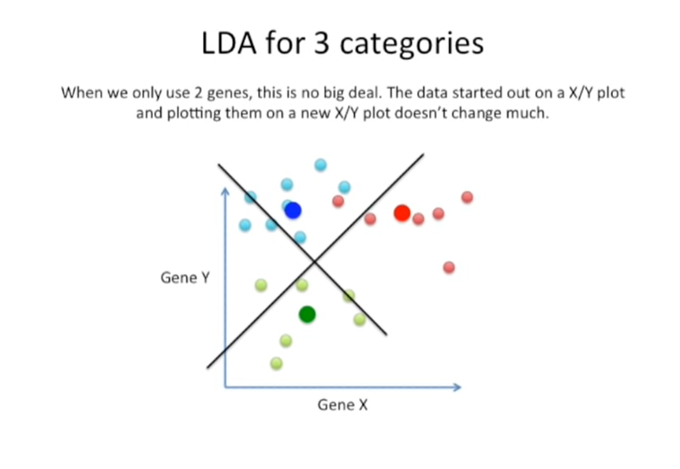

Slide 34
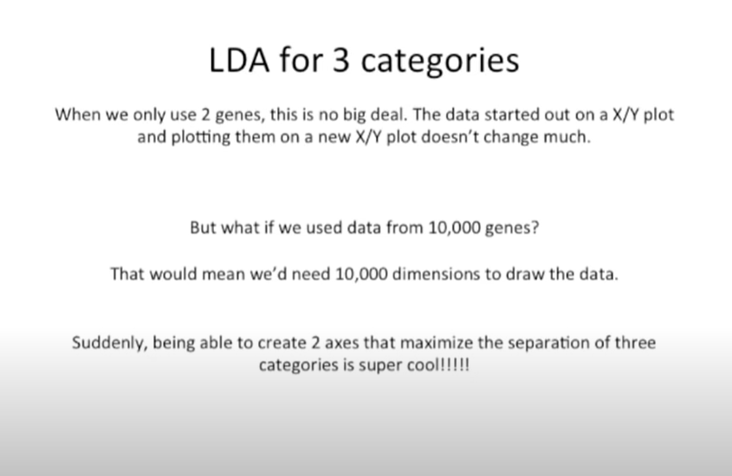

Slide 35
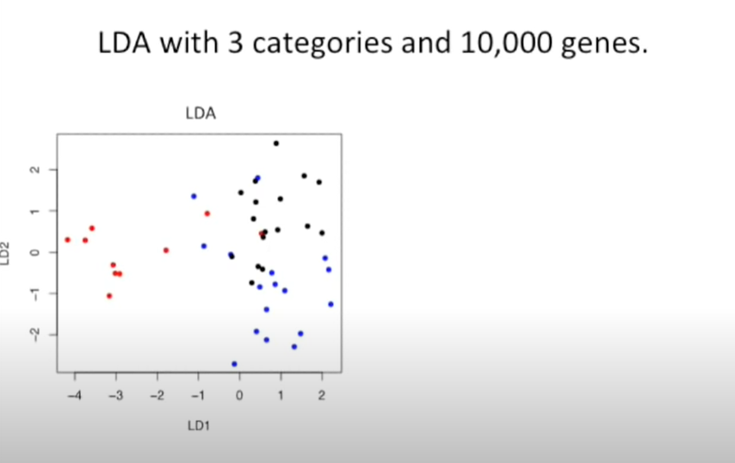

Slide 36
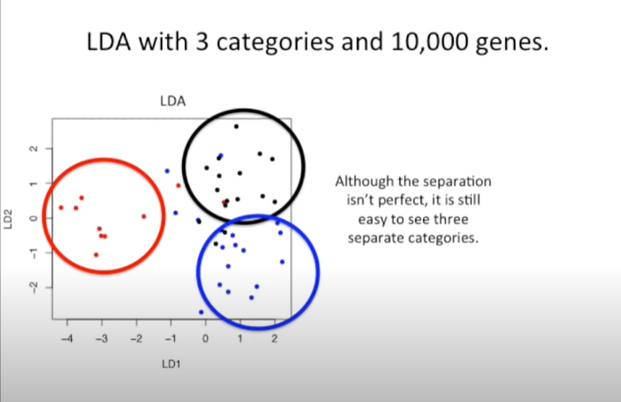

Slide 37
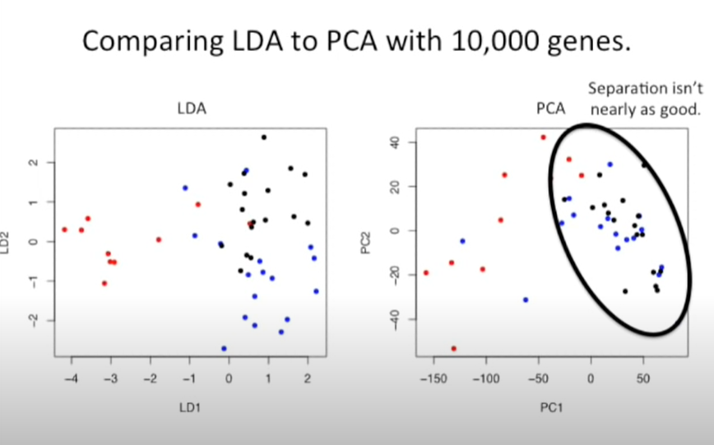

Slide 38
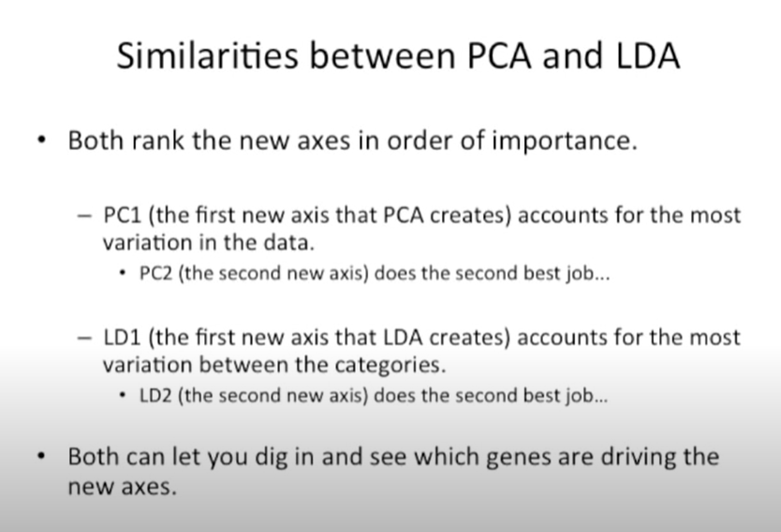

Slide 39
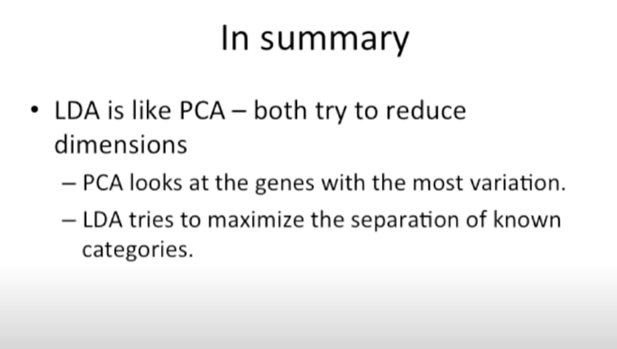

Slide 40
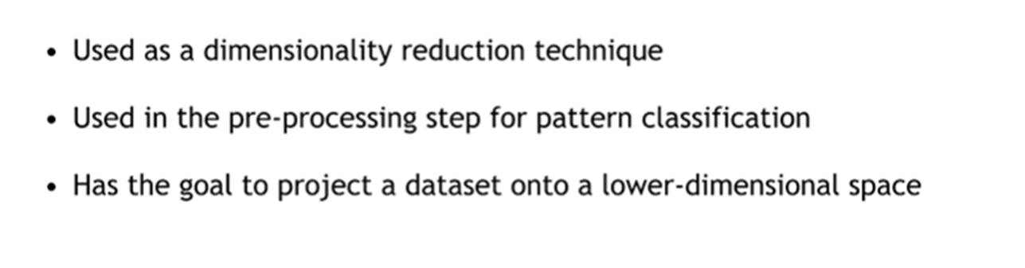
Linear Discriminant Analysis (LDA)

Slide 41
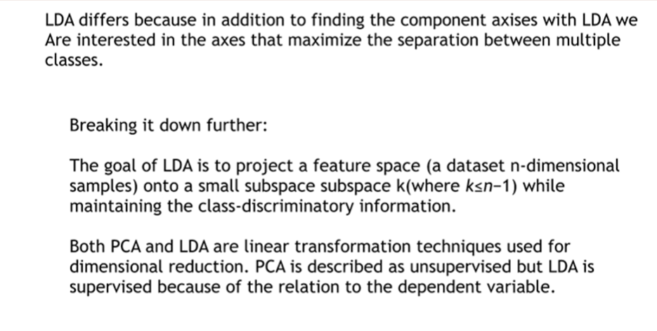
Linear Discriminant Analysis (LDA)

Slide 42
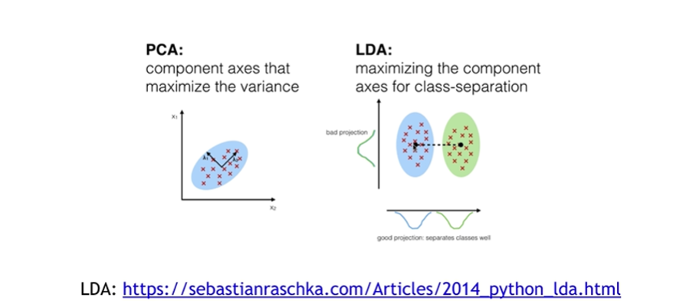
Linear Discriminant Analysis (LDA)

Slide 43
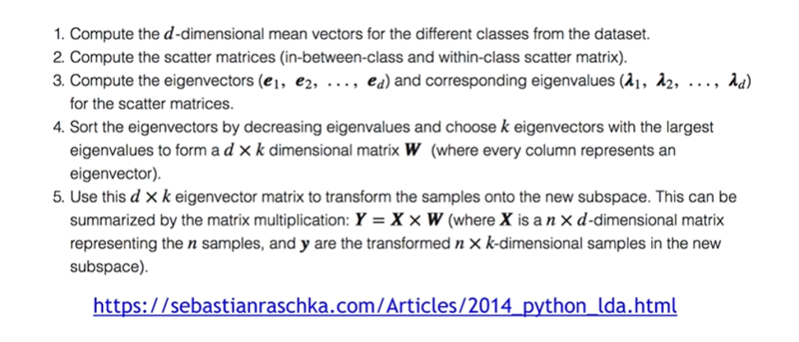
Linear Discriminant Analysis (LDA)

Slide 44
Difference Between PCA and LDA
Features | Principal Component Analysis (PCA) | Linear Discriminant Analysis (LDA)
Discrimination between classes | Discover the relationship between independent variables | Discover Relationship between independent and dependent variable
Supervised Learning Technique | PCA is an unsupervised technique | Used for Prediction of classes. LDA is a supervised learning technique that relies on class labels.
Focus | Used for reducing the variables based on collinearity of independent variable. PCA searches for the direction that have the largest variations. | Used for variable reduction based on strength od relation ship between independent and dependent variable

Slide 45
Difference Between PCA and LDA
Features | Principal Component Analysis (PCA) | Linear Discriminant Analysis (LDA)
Direction of Maximum Discrimination | Finds the direction that maximizes the variance in the data. The direction of maximum variance is not necessarily the direction of maximum discrimination since there is no attempt to use such as the between class scatter and with in class scatter | Finds the direction that maximizes the difference between two classes. LDA is guaranteed to find the optimal discriminant directions when the class densities are Gaussian with the same covariance matrix for all the classes.
Well distributed classes in small data sets | PCA is less superior to LDA | LDA is superior to PCA

Slide 46
Difference Between PCA and LDA
Features | Principal Component Analysis (PCA) | Linear Discriminant Analysis (LDA)
Computations for Large Data Set | PCA require fewer computations. | LDA require significantly more computation than PCA for large data sets.

